Slide 1
Final Project Assignment:
Home Ownership Data
Jenny Tran

Slide 2
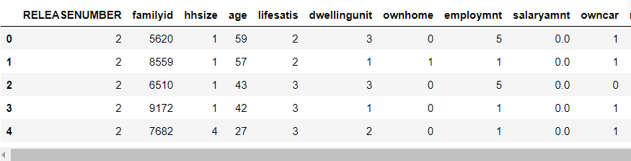
About the Data
Stores information on various attributes related to different families
9,607 rows & 19 columns of data

Slide 3
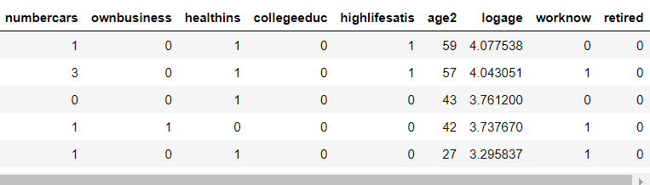
About the Data

Slide 4
About the Data: Strengths & Shortcomings
Strengths: contains a lot of information, covers multiple aspects of the individuals lives, large sample size
Shortcomings: has duplicate columns, contains values that are assumed to be associated with a number or ranking (can be seen in the “dwellingunit” & “employmnt” columns)

Slide 5
Frame the Problem
Can life satisfaction be predicted using other attributes in the dataset? Which variable is the best predictor of life satisfaction?

Slide 6
Wrangle the Data: Change Column Names
Before After
salaryamt → salary
worknow → employed
employmnt → employstatus

Slide 7
Wrangle the Data: Removing Columns
Delete “RELEASENUMBER” column because it contains the same values for all rows
Delete “age2” because it is a duplicate column
As a result, there are now 17 columns in the dataset

Slide 8
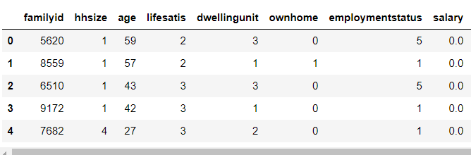
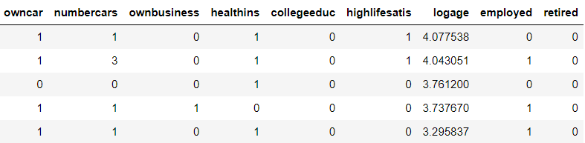
Wrangle the Data

Slide 9
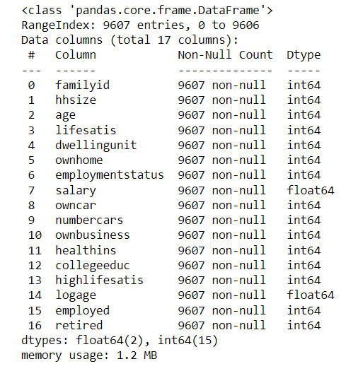
Wrangle the Data: Checking Data Info
All data types appear to be correct & there not any columns with missing values

Slide 10
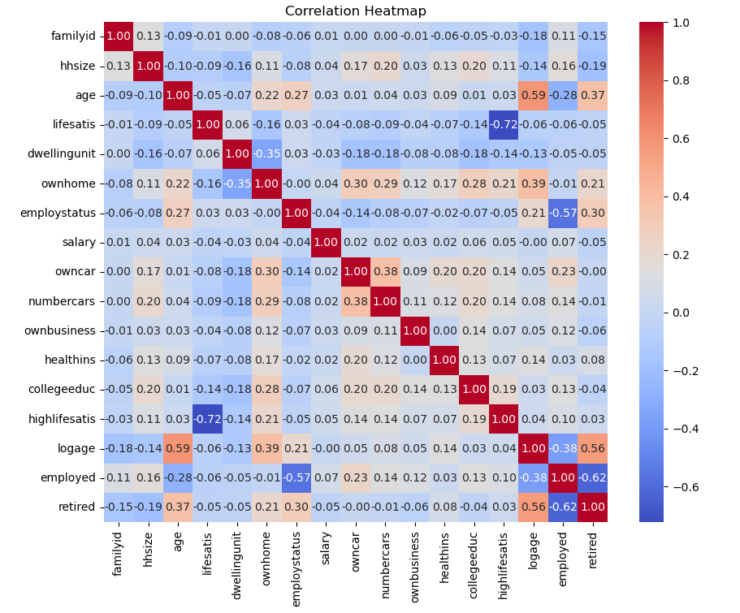
Data Visualization: Correlation Matrix

Slide 11
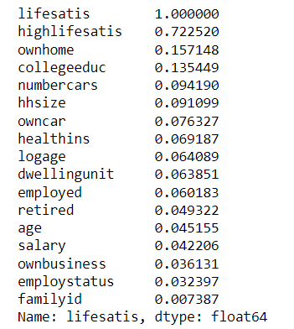
Data Visualization: Correlation Matrix
highlifesatis and ownhome have the highest correlation with lifesatis

Slide 12
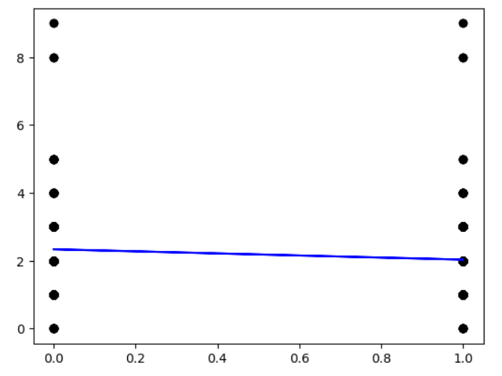
Machine Learning: Linear Regression
ownhome vs lifesatis
MSE = 0.91
R-square = 0.02
Home ownership is not a good
predictor of someone's life
satisfaction
Life satis
ownhome

Slide 13
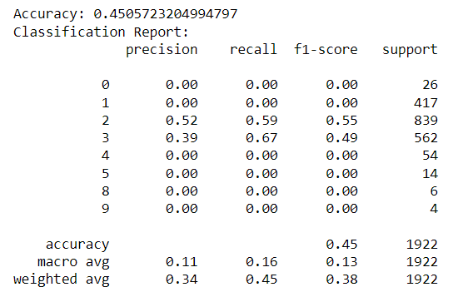
Machine Learning: Classification
Accuracy: 45%, slightly low
F-1 scores shows that the model is not correctly identifying positive instances
The model’s performance is poor

Slide 14
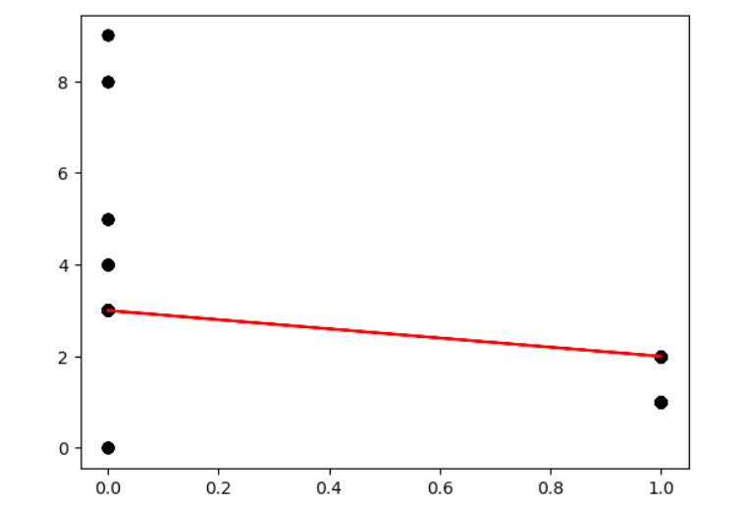
Machine Learning: Linear Regression
highlifesatis vs lifesatis
MSE = 0.47
R-square = 0.49
High life satisfaction is a better
predictor of someone's life
satisfaction
Life satis
highlifesatis

Slide 15
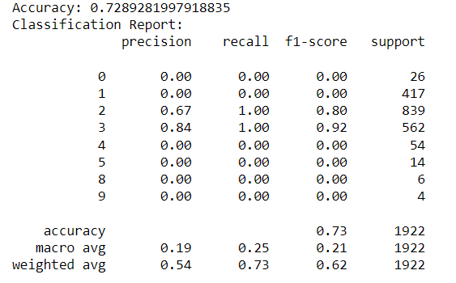
Machine Learning: Classification
Accuracy: 73%, above average
F-1 scores shows that the model is not correctly identifying positive instances
The model’s performance is poor

Slide 16
Conclusion
Most of the variables in this dataset have low correlation with life satisfaction
Out of all the variables, high life satisfaction is the best predictor of life satisfaction
However, high life satisfaction is still not a good predictor of life satisfaction

Slide 17
Thank You!

